Slide 1
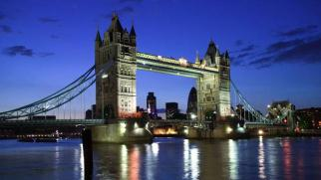
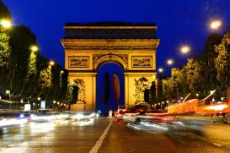
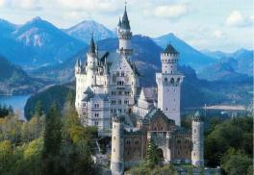
London, Paris & Alps
March 8-17, 2014

Slide 2
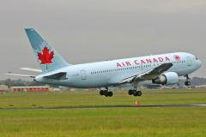
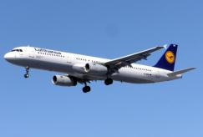
Flights
Saturday, March 8, 2014
Meet in the front lobby of the school @ 3:00 p.m. and load bus with luggage. PASSPORT CHECK!
Sharp Bus to Airport departs BCI at @ 3:30 p.m. arrive @ 4:45 p.m.
Flight #848 Air Canada departs Toronto (Pearson) for London (Heathrow) at 8:20 p.m
NB: Daylight Savings Time begins in Canada Sunday March 9 @ 2am; European Summer Time begins in Europe March 30th @ 1am
Depart | Date | Time | City (airport) | Flight Info
 | 3/8/2014 3/9/2014 | 8:20 PM 8:25 AM | TORONTO - PEARSON INTERNAT'L London (Heathrow) | Air Canada Flight # 848

Slide 3
Monday, March 17, 2014
Coach bus departs hotel
Lufthansa (Munich) flight #109 departs at 2p.m. for Frankfurt
Air Canada (Frankfurt) flight #877 departs for Toronto (Pearson) at 5p.m. arriving 8:25p.m. (local time).
Sharp Bus pick up @ Pearson @ 9:15 p.m. arriving @ BCI @ 10:45 p.m. (fingers crossed!) **Telephone tree**
Return | Date | Time | City (airport) | Flight Info
 | 3/17/2014 3/17/2014 | 2:00 PM 3:05 PM | Munich Frankfurt | Lufthansa Flight # 109
 | 3/17/2014 3/17/2014 | 5:00 PM 8:25 PM | Frankfurt TORONTO - PEARSON INTERNAT'L | Air Canada Flight # 877

Slide 4
Things for this meeting
As per our last meeting…
Copies of passport in COLOUR x2
Medication Form (copy of rx)
Signed permission form
$75 cash (Canadian) to cover tips during the trip (EFtour guides and bus drivers)
A cheque made out to Bluevale C.I. to cover the travel expenses to and from Pearson Int. Airport= $42 TOTAL for return trip using Sharp Bus Lines. (If there are any flight delays or cancellations, this amount may need to be adjusted)
Any questions you may still have!

Slide 5
EF & Airline Contacts
EF Educational Tours
1-800-263-2806
www.eftours.ca
Air Canada
1-800-630-3299 1-888-247-2262
Lufthansa
1-800-563-5954

Slide 6
Keeping in Touch
Phone tree for emergencies, change in itinerary, arrival at home March 17th **Please verify number tonight**
EF Toronto: 1-800-263-2806
Phone cards
http://mrsharnack.weebly.com/eftours.html
https://twitter.com/BCItours
Follow on twitter @BCItours

Slide 7
Hotels
We will provide hotel information ASAP
Students will have hotel information address « stickers » to add to their EF Education First booklets

Slide 8
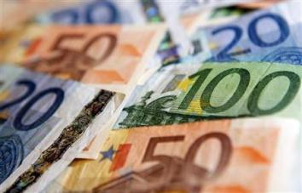
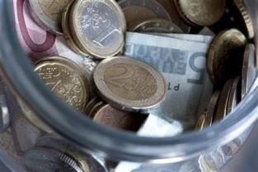
Budget
Exchange c. $50 into Pound/Euro
Debit/Credit cards
Call ahead
Have 4 digit pin
(Traveller’s cheques)
25£ Pound for London Eye
35€ for Montmatre/Paris Evening Tour
30€ for additional added tour experience
Travel safely with money
A money pouch or neck pouch is the best way to carry money.
Canada Customs Declaration Card
$800 limit incl. Alcohol* & Tobacco*
Keep track of receipts

Slide 9
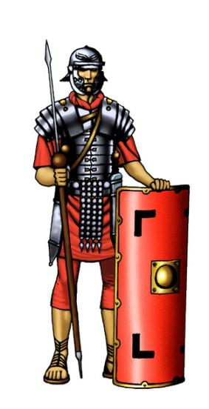
Safety during Travel
Students will be divided “attendance groups” each led by one of your chaperones.
EF Safety First Policy
Local office in London, Paris and Munich
Hotel locations
Telephone Chain Chart
Government of Canada
Travel Reports & Warnings
http://www.voyage.gc.ca

Slide 10
Golden Questions
We will ask these questions everytime we leave a hotel on tour.
Is your luggage on board?
Is your group leader on board?
Is your tour director on board?
Is your bus driver on board?
Do you have your passport? Touch it/show it.
Did you return your key?
Did you remember your charger for electronic devices?
Did you visit the restroom?
Currency Conversion Calculator
This website will allow you to print out a pocket sized currency conversion for all of the countries you are visiting! http://www.oanda.com/currency/converter/

Slide 11
The daily grind
Wake Up: Normally, your TD will suggest a wake up time (e.g. 7 am), which is normally 45 minutes before breakfast is available (e.g. 7:45 am), which is normally 45 minutes before the group needs to depart for the day’s activities (e.g. 8:30 am).
Students, who may be roomed in pairs-quads, could split who has a shower the night before, and who has a shower in the morning, or to set their alarms earlier to accommodate their need for time in the bathroom.

Slide 12
Packing
EF backpack
Carry on restrictions
Water bottles
One suitcase only
weather
layers
comfort
dress code
Locks
Please refer to baggage allowance on website: http://mrsharnack.weebly.com/eftours.html

Slide 14
STAIRS!
YOU will be carrying everything you bring. Up and down stairs…☺ Many European hotels do not have an elevator
When leaving the hotel we will stagger luggage being brought down by room at 5 minute intervals. So we are on the bus, not in the stairs, when we need to depart.

Slide 15
Health & Medication
Pack meds in carry-on luggage in original container
Time zone (+6)
Motion sickness
Menstruation

Slide 16
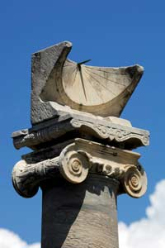
Behaviour & Etiquette
Punctuality
Hotel
No opposite genders in rooms
Common area for social activities
Bed check/Lights out
Touring etiquette
Airplane
Hats
Cameras
Conduct
No smoking, alcohol*, drugs
Violators will be sent home at parents’ expense
Notes:
No strong perfume/cologne
Seat back goes upright during meals

Slide 17
A 1-Way Flight Home…

Slide 18
EF SWAG
Backpacks
Travel booklets
Information

Slide 19
Lunch Meetings
Lunch Meeting Thursday February 27th and March 6th at the beginning of lunch in Mrs. Harnack’s room 2120
Last minute questions
German and French 101 (Jung and Harnack)
Rooming
Hotel information and stickers for EF booklet
Fun Pre-trip bonding! ☺

Slide 20
Questions?

