Slide 1
Canadian Women Over the Years
Lilian Alarashi, Mackenzie Meldrum,Mikayla Mueller, Sarah Bishop, and Cora Culley

Slide 2
Timeline
Women in the Olympics (1900)
The Arts (1910-1919)
Women’s role in World War 1(1914-1918)
Prohibition (1918-1921)
Suffrage (1918-1940

Slide 3
Women in Sports
By: Cora Culley

Slide 4
Cora
Women in Sports
Looking back decades ago, women had no rights and were not equal to men. Around the 1920’s this had all changed. Women started fighting more for their rights and freedom. This can clearly be shown through women’s roles in the athletic world. Looking at a big event such as the modern Olympic Games, we see how women were not well represented. Participation in the Olympic Games back then was limited to male athletes only. The only way women were able to take part in the games was to enter a horse into the equestrian events. In the 1900 Paris Games, female athletes participated for the very first time with the inclusion of women’s events in lawn tennis and golf. As the years went on, many more female athletes participated in the Olympic Games. In the 1900 games there were 22 women competing from a total of 997 athletes. In the 1912 games there were 48 women competing in 102 events in 14 different sports. To this day, women are becoming more and more powerful in the sports industry. 13% of the participants in the 1964 Tokyo games were women, 23% of the participants in the 1984 Los Angeles Games were women, and in the 2012 London Games, 44% of the participants were female athletes. The number of women competing in the Olympic Games has increased greatly since the 1970’s. From these statistics, we see how women are slowly gaining rights and equality in sports. This shows people how powerful women are when they come together and fight for something that they believe in. As the female athlete population was increasing greatly each time the Olympic Games were held, so were the number of events that women were allowed to compete in. There were only two Olympic events where men and women competed directly against each other, equestrian and sailing. In 1912, women competed in swimming events for the very first time. The 1928 Summer Olympic Games in Amsterdam were the first Olympic Games that allowed women to participate in gymnastics and track and field events. Women’s shooting events were first included in the 1984 Olympics and the 2000 Olympic Games were the first time that women were allowed to compete in weightlifting. From the listed information above, we see how the female voice is starting to be heard throughout the sports industry and some changes are being made to give women equal rights in sports. Women have fought for their rights and equality in sports for a very long time now. Fortunately, their fight is over. In 2012, women’s boxing was introduced into the Olympic Games, resulting in no remaining sports that do not include events for women. Women have had a long and hard fight in the sports industry but it is finally over, women have finally won their rights.

Slide 5
Historical Significant
Cora
I believe that the increasing number of women participating in sports events such as the Olympic Games and the increasing amount of female events in various different sports is a historically significant event in this time period because it was one of the main turning points for women’s rights
Women fought for a very long time to gain their rights and equality in sports and eventually gained complete power at the 2012 London Games

Slide 6
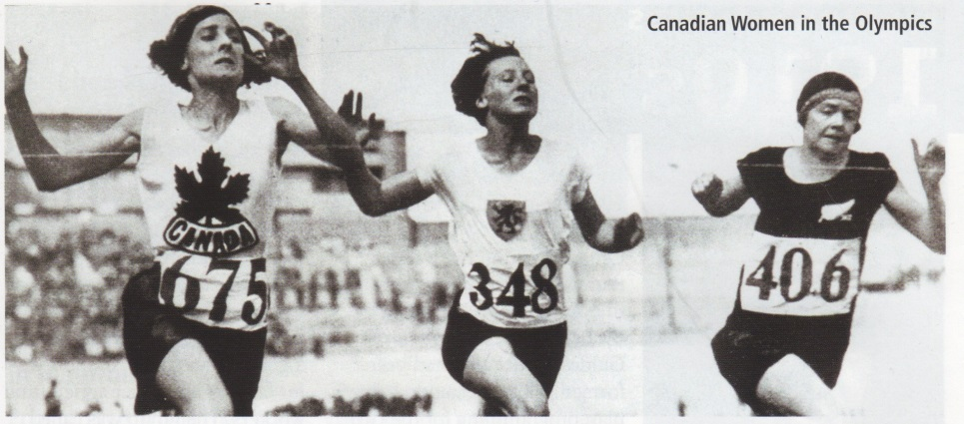
Primary Source
Cora
This is a picture of the Canadian women 4 x 400-metre relay team consisting of Myrtle McGowan, Fanny Rosenfeld, Ethel Stewart, and Florence Doane
This relay team had a gold medal run that also resulted in a new world record for that distance
This picture is from the 1928 Summer Olympic Games in Amsterdam
This primary source tells us how Canadian women finally gained their rights and equality in sports, this also shows how Canadians are becoming more accepting of women as people
This source shows a change that made life better for Canadians because the women in the picture have proven that women can be equal to men and can do everything that men can do
Morrison, Jessica. Canada Past. Present. Future: Women's issues. Calgary, Alberta, Canada: Weigl Educational

Slide 7
Source ID Page:
Cora
Books:
Morrison, Jessica. Canada Past. Present. Future: Women's issues. Calgary, Alberta, Canada: Weigl Educational Publishers Limited, 2011. Print..
Pictures:
Morrison, Jessica. Canada Past. Present. Future: Women's issues. Calgary, Alberta, Canada: Weigl Educational Publishers Limited, 2011. Print.
Websites:
“topendsports." Olympic Games: Women at the Olympics. Topen Sports Network, 17 04 2013. Web

Slide 8
Canadian Women and The Arts
1910-1919
Mackenzie

Slide 9
Descriptive Paragraph
Mackenzie
Actresses
The arts were very popular from 1910-1919
Talented actress Mary Pickford started the “United Artists”
This was a group of actors, directors, etc. who created their own film company
They produced and distributed their own films
Competing with major Hollywood companies
Filled with well known actors
It was very successful
Another talented actress at that time was Nell Shipman
Produced, directed and acted in the film that was her break out success God’s Country and the Woman.
One of the first movies to be shot almost entirely on location
That was new at the time
Her movies were known for the scenery and use of wild animals
Her name started to die down in the 1920’s
Dance
Waltzes and Polkas were popular in the 1910’s
Canadians wanted a new kind of dance
Unsuccessful to find their new dance, first they tried the fast-paced fox trot, and turkey trot
Took an instant liking to Latin music and dance
Physically demanding and complicated dance steps
Practice before performance
Lots of movement
Retirement of long, restricting dresses

Slide 10
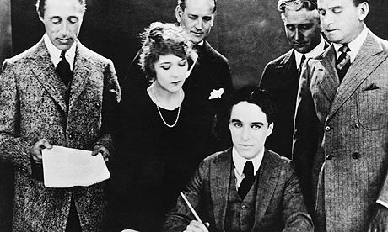
Primary Source
Mackenzie
This is a picture of the United Artists signing a document
This shows the break through of talented actors in that time
Independence
Integrity
Dedication
Inspiring because a women started the United Artists
Successful
http://www.guardian.co.uk/film/2009/jun/13/hollywood-charlie-chaplin

Slide 11
Historical Significance
Mackenzie
It was significant for women in that time to be as successful as Pickford and Shipman were
Significant that the United Artists was as successful as it was
Latin dance became one of the typical dances among Canadians
Rating: +2
I would rate the historical significance of Canadian Women and The Arts a +2. It was impressive for women at that time to be as successful as Nell Shipman and Mary Pickford were. It was significant that a women came up with an idea that turned out to be a very successful business that many people got to witness throughout their movies. Latin dance was the start of a new trend and new clothing choices.

Slide 12
Sources
Mackenzie
Cochrane, Kira. “Hooray for Hollywood.” The Guardian. Edition: UK. N.p. N.d. 2013-26-04
Craats, Rennay. Canada through the decades THE 1910’s. Canada: Calgary, 2000. Print.

Slide 13
Canadian Women and their role in world war 1
Mikayla

Slide 14
Descriptive Paragraph
Mikayla
Women had a huge part in world war one, which took place between 1914-1918
Before the war many of the jobs that were available to women were low paying and offered little chance of advancement. They were expected to end their career once married.
Once WW1 began the women flooded into the labor market to replace the men who had gone to fight.
Over 30,000 Canadian women worked in factories making guns, bullets, bombs uniforms, ships, tanks and planes. They were also employed as welders, fitters, machinists, riveters and numerous other jobs that, before the war, were considered men's jobs.
Women were not allowed to sign on as soldiers, sailors or pilots but more than 3000 Canadian women enlisted as nurses. They took care of the wounded/dying soldiers.
The nurse’s still had the risks of getting wounded or killed when hospitals came under fire and they also had the risk of picking up infections or diseases.
About 1,000 Canadian women were employed by the Royal Air Force as truck drivers, mechanics and ambulance drivers.
Thousands of Canadian women who stayed home started fundraising money for the war

Slide 15
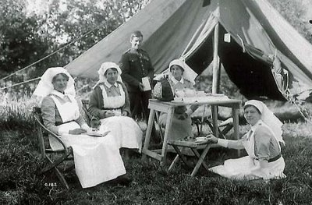
Primary Source
Mikayla
This is a photograph taken from July, 1916 of four Canadian Nursing Sisters and a solider.
This primary source is at No. 3 Casualty Nursing Station
This photo tells us that Canadian women are just as capable as the men and they also played a huge part in the war.
This primary sources shows a change that made life better for Canadians because this provided women with work. Most Canadian women were given jobs as nurses in the war, helping to heal Canadian soldiers faster.
http://maryswritingnook.blogspot.ca/2008/11/canadas-nursing-sisters.html

Slide 16
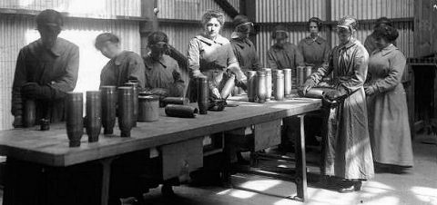
Historically Significant
Mikayla
I think this event is historically significant because it gave women the opportunity to show a male dominate society that they could do more than just raise children and tend a home.
It gave them a chance to contribute to the war, considering a lot of the jobs were not available to women at the time.
This also lead to women gaining fore independence and the ability to vote.
Ranking:4
I think women's involvement in the war is a 4 because it proved to Canadians the capability the women have, which would give them jobs in the future. It also gave the women an opportunity to prove that they are just as equal as the men are.

Slide 17
Sources
Mikayla
Colyer, Jill et al. Creating Canada. Whitby: McGraw- Hill Ryerson, 2010. Print.
Don Quinlan, Jan Coomber, Rosemary Evans. Women Changing Canada. Don Mills: Oxford University Canada,1997. Print.
McCrackin, Laura. “Women's Roles in Canada During World War I and the Suffragist Movement.” History Archive. N.p. N.d. 25.Apr 2013. Web.
“Women in world war 1.” Tripod. N.p. N.d. Web. 25 Apr 2013. Web

Slide 18
Woman ban alcohol (prohibition)
Canadian women
Lilan Alarashi

Slide 19
Descriptive Paragraph
In the early 20th century alcohol was blamed for many social problems such as crime, public drunkenness, family violence and poverty
The outcome of this was the temperance movement which called on people to refrain from drinking alcohol
Gained ground in North America
If people stopped spending money on alcohol many families would be able to improve their lives, which is what the temperance societies believed
The woman’s Christian temperance union campaigned for total prohibition on alcohol
Nellie Clung and Louise McKinney (who were members of the famous five) became members of the movement
Before and during world war 1 the temperance movement led to the banning of alcohol in numerous provinces as well as Alberta and Ontario.
Selling alcohol was illegal, bars were closed
In 1918 under the war measures act, the federal government enacted prohibition- laws against making and selling intoxicating liquor
This ban continued until a year after the war ended
Brisk illegal trades in alcohol started happening because not all Canadians were happy with prohibition
Criminals become rich after selling expensive illegal liquor to Canadians
Governments lost the income made by alcohol taxes
By 1921 provincial governments began to repeal prohibition laws and replace them with government-controlled liquor sales
The united states government had also introduced prohibition
The us laws remained in effect well after prohibition had ended in Canada
This created a profitable business opportunity for Canadian liquor companies
Every year “rum runners” transported about 45 million liters of liquor into the U.S. often through remote land crossings or across lakes and rivers in boats
Small-scale smugglers often hid liquor containers in their clothing , in baby carriages or in other ways
Larger-scale smugglers used fast boats or cars to bypass border checkpoints
Prohibition lasted for 13 years, in 1993 alcohol became legal again

Slide 20
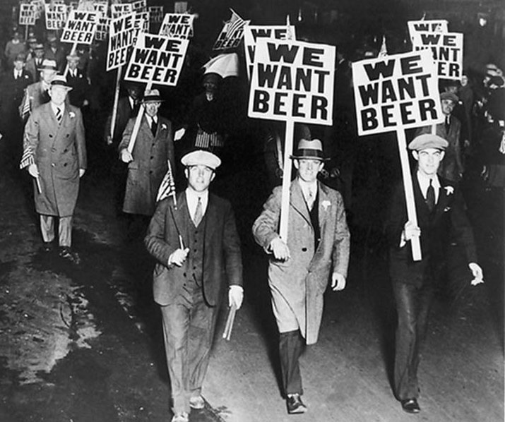
Primary source
This visual is important to the prohibition because it shows the many who didn't’t agree with illegalization of alcohol. Many people started protesting, the protests started happening in larger scales.
"Home English Blog: Prohibition Era." Home English Blog: Prohibition Era. N.p., n.d. Web. 26 Apr. 2013.

Slide 21
Historical significance
This event is historically significant because it was the first and only time an amendment to the U.S constitution was repealed
After the prohibition was made it didn’t stop drinking, just drove it underground. Ordinary citizens had to become “outlaws” to sip a beer. The black market grew and thrived, which operated violently costing many lives
Exposed our need to possibly sacrifice our morals to save our economy
The prohibition had a negative impact because it created disrespect for the law and religion and created organized law
People made their own 'bootleg' alcohol, ignoring all governmental standards like quality and sanitation. Many were poisoned by drinking wood alcohol.
Imported alcohol was also brought in from outside of the country. Many criminal organizations developed from the importing, transporting and selling illegal alcohol
Rank: -4 the economy took a major hit, because of the loss of tax revenue and legal jobs. Contaminated liquor contributed to more than 50,000 deaths. By the end of the 1920s there were more alcoholics and illegal drinking establishments than before Prohibition.

Slide 22
Sources
"How Prohibition Worked." HowStuffWorks. N.p., n.d. Web. 26 Apr. 2013.
"12 Bad Effects of Prohibition You Should Know." Unreasonable Faith. N.p., n.d. Web. 26 Apr. 2013.
Baldwin, Douglas. Canadian Decades: 1920s. Calgary, Alberta: Weigl Educational Limited, 2011. Print.
The Crazy Twenties: 1920/1930. Toronto: Natural Science of Canada, 1977. Print.

Slide 23
Canadian Women and Suffrage
1918-1940
Sarah Bishop

Slide 24
The Right to Vote
Sarah
The National Council of Women of Canada was founded in 1893
The leaders of the movement were Nellie McClung, Henrietta Edwards, Louise Mckinney and Emily Murphy
Ontario was the first province to allow some women to vote
On January 27th 1916 Manitoba gave all the women of Manitoba right to vote
In 1917 some women that had a husband active in war or were widows could vote
In 1918 some women were given the right to vote because their husbands were off at war
In 1918 women in Alberta, Manitoba, Saskatchewan, British Columbia, Ontario, and Nova Scotia could vote in provincial elections
On May 24th 1918 all females 21+ could vote in federal elections
Quebec was the last province to allow women to vote in 1940
The campaign was very peaceful compared to the British, French, and American women’s rights movements

Slide 25
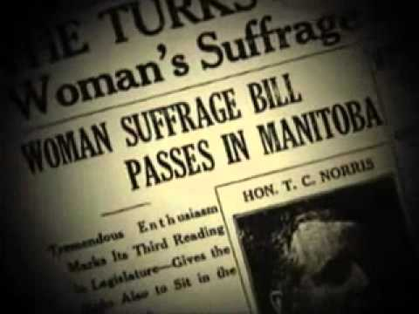
Primary Source Evidence
Sarah
This is a newspaper article from a Canadian newspaper in 1916
Shows how monumental the event was
Communicates to women what is happening in other provinces
This source shows how impactful women gaining the right to vote in Canada was
thomasghi.edu.glogster.com

Slide 26
Historical Significance
Sarah
Created equality between men and women across Canada
Women gaining a vote also influenced things like
Women running for parliament
Women being appointed senates and judges
Women gaining higher education
Becoming people by law (persons case)
Helped make women be more independent
Ranking: 4
This is historical significant because it ultimately gave women equal rights and allowed their views and opinions be heard across Canada. It also gave women the status of an equal person

Slide 27
Sources
Sarah
Colyer, Jill et al. Creating Canada. Whitby: McGraw- Hill Ryerson, 2010. Print.
Don Quinlan, Jan Coomber, Rosemary Evans. Women Changing Canada. Don Mills: Oxford University Canada,1997. Print.
Susan Jackel. Women’s Suffrage. The Canadian Encyclopedia, 2010. Web.
Women’s Suffrage. Our Nellie. Web.

