Slide 1
Government Key Events
By: Alex Clark, Jameson Kunkel , Varjil Pathak, Anan Almoalim and Brendan Doyle

Slide 2
Topics
1.
2.
3.
4.
5.
Voting Rights For Women1916 – 1918
Conscription Crisis of 1917
League of Nations 1919 – 1945
Prohibition of 1920
Statute of Westminster 1931

Slide 3
Voting Rights For Women
1916 - 1918
Varjil Pathak

Slide 4
Key Points
Nellie McClung led the fight for the women's vote in Canada
She decided to do it because women were not treated equally.
Opposition leader Liberal T.C. Norris agreed to give women the vote if he became Premier in the 1915 election- he won
On January 28 1916 the women of Manitoba got the right to vote provincially and all the other provinces followed shortly
First time women got the right to vote federally was when they voted for conscription on September 20, 1917
Conscription was important for the government because they needed more troops to go fight in Europe. They imposed it August 28, 1917
Only a few select were allowed vote : the wives, mothers and sisters of serving soldiers, as well as women serving in the armed forces.
The government didn’t allow any women who were not involved in the war and enemy aliens ( Germans, Austria Hungarians) to vote for conscription
In 1917 Prime Minister Robert Borden equaled women's suffrage because he wanted to win in the 1918 election- he won

Slide 5
Key Points
On May 24, 1918 all the women of Canada had the right to vote federally because the Women's Franchise Act was passed
Some other people in the government did not like that women got the right to vote. Some said that politics is too corrupt for women or that allowing women to vote will cause arguments in the home. If the wife and the husband are voting for different people than they could start fighting about which candidate is better or why did the other person choose him/her (election candidate).
A long time after the act was passed the famous five (Emily Murphy, Irene Parlby, Nellie McClung, Louise McKinney, Henrietta Muir Edwards) fought for women to be considered persons and won the Persons case (October 18, 1927- October 18, 1929) which stated that women are people; before women were considered things or objects

Slide 6
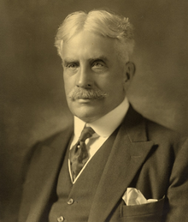
Primary Source
This is a picture of Prime Minister Robert Borden. He represented the conservative party. This picture is important because he equaled women’s suffrage in return for their vote. He only allowed women to vote because he wanted to win the federal election of 1918. His campaign worked and Robert won by a landslide.
http://en.wikipedia.org/wiki/Robert_Borden

Slide 7
Historical Significance
This is historically significant because it is one of the biggest changes to happen in Canada. It helped in allowing the constitution to adapt to change later on when women were considered persons. Secondly, it helped make choices in government more equal. There were more voters to equal out the votes. Women could choose who they wanted to be prime minister instead of just men voting. Lastly it was important because it was the first step that helped women to get equal rights ( equal pay, not treated differently, etc.) in 1929 after the women won the privy case. Women were inadvertently part of creating a national divide. They voted for conscription which the French in Canada were against. The women were used by the government to make sure that conscription happened. In return for their (the women’s) vote the government allowed the women to vote.

Slide 8
Ranking
+3- I marked this as +3 because it helped make decisions more fair in the Canadian Government. There were more voters to equal the decision. Women could vote for who they wanted. When women voted for conscription the decisions were unfair because not all women got the right to vote. This was the first step towards helping women to be considered persons.

Slide 9
Sources
1. “Women get the Vote.” Le Canada: A People’s History. N.p. N.d. April 20, 2013
2. “When did Women get the Right to Vote.” Wikianswers. N.p. N.d. April 20, 2013
3. “The Famous Five.” Wikipedia. N.p. April 19, 2013. April 20, 2013
4. “Women’s Right to Vote in Canada.” Parliament of Canada. N.p. April 2, 2013. April 20, 2013
5. “Women’s Suffrage.” Wikipedia. N.p. April 19, 2013. April 20, 2013
6. “Wartimes Election Act.” The Canadian Encyclopedia. N.p. N.d. April 20, 2013
7. “The Persons Case.” Global Perspectives on Personhood: Rights and Responsibilities. N.p N.d. April 20, 2013
8. “Women's Suffrage.” The Canadian Encyclopedia. N.p. N.d. April 20, 2013

Slide 10
Brendan Doyle
Conscription Crisis of 1917

Slide 11
The Conscription Crisis
On August 29th 1917, Borden, the current Prime Minister (Canadian Government), passed the Military Service Act allowing the government to conscript men if the Prime Minister felt that it was necessary. This happened because after the Battle of the Somme, Canada had a desperate need to replenish it’s troops when there were few volunteers to replace them. This was carried out by the Government mailing out letters instructing the conscripted to come down to the local barracks.

Slide 12
The Conscription Crisis
Who: Canadian Government, English and French Citizens, Canadian Army
What: Government introducing Conscription
Where: Canada
When: Around August 1917
Why: Canada needed new troops after the Battle of Somme and no new soldiers

Slide 13
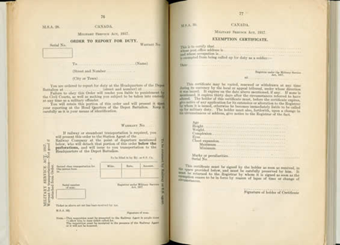
Primary Source
This source is important to the
Conscription Crisis of 1917 because
this is an image of the form a
conscripted man would get in the mail
This source is related to the Canadian Government because they created the form and enforced it throughout the crisis
http://www.warmuseum.ca/cwm/exhibitions/guerre/photos/565/e-ub_345_c2_c036_c.jpg

Slide 14
Historical Significance of the Conscription Crisis
1) One way that the Conscription Crisis is historically significant is that for the first time ever Women were given the chance to vote
2) The Conscription Crisis left English-Canadians and French-Canadian divided for many years
3) Dissent with Borden’s government after the crisis lead to the development of new federal and provincial government parties
Ranking: (+2) Reasoning: I think the Conscription Crisis ranks at a +2 because this event had a major impact on the Canadian Citizens for a lasting duration. For example, Conservatives were virtually shut out of Quebec for 50 years.

Slide 15
Sources
"Conscription Crisis of 1917." Wikipedia. N.p., 28 Febuary 2013. Web. 23 Apr. 2013.
“Historical Significance.” Maple Leaf Web. N.p., N.d. Web. 26 Apr. 2013
“Conscription, 1917.” Canadian War Museum. N.p., N.d. Web. 26 Apr. 2013S

Slide 16
League of Nations
1919 - 1945
Anan Almoallim

Slide 17
Key Points
League of Nations is an international governmental organization that was founded as a result of the Paris Peace Conference in 1919 that ended the First World War.
Its main mission was to maintain world peace and avoid wars between countries
At its highest peak from September 28th 1934 – February 23rd 1935, the organization reached 58 members.
Canada joined the organization independently from Britain.
The United Nations (UN) replaced the League of Nations in 1945

Slide 18
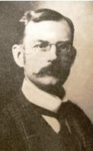
Primary Resource
Sir Herbert Brown Ames:
Born June 27, 1863 Montreal, Canada East
Died March 31, 1954 (90yrs) Montreal, Canada
Won election to the House of Commons as a Conservative
Was appointed a financial director for the League of Nations
He is very important because he had the highest job in the league as a Canadian.
http://www.parl.gc.ca/ParlInfo/images/Picture.aspx?Item=4fcbfd85-6619-40f3-a285-b11eacdd2311

Slide 19
Significance to Canadian History
1. Canada's first official contact with foreign governments.
2. Canada's independence starts when joining the organization apart from Britain.
3. Started “peace keeping” as being a part of the Canadian Identity.
4. Set the tone for later a Canada joins the United Nations (UN).
Between -5 and +5, I would rank this event as a +3 because it was not as significant at the time since the League of Nations was not very successful. However it was a significant event to Canada’s Identity as an individual.

Slide 20
Sources
“Parlinfo.” www.parl.gc.ca. Library of Parliament. n.d. Web. 25 April 2013
Regehr, T.D. “Sir Herbert Brown Ames.” www.thecanadianencyclopedia.com. The Canadian Encyclopedia. n.d. Web. 25 April 2013
Trueman, Chris. “League of Nations.” www.historylearningsite.co.uk. N.p. n.d. Web. 23 April 2013.
Veatch, Richard. “League of Nations.” www.thecanadianencyclopedia.com. The Canadian Encyclopedia. n.d. Web. 23 April 2013.

Slide 21
Prohibition of 1920
Alex Clark

Slide 22
Prohibition of Alcohol
Near the turn of the century the Canadian government decided that they were going to introduce the option of prohibiting alcohol to the provinces. Early in the 20th century alcohol was widespread and the government wanted to stop the distribution and consumption of it. The first province to enact this was P.E.I. in 1901 and it was followed by Ontario and Alberta in 1916. Quebec briefly had it in effect before it was revoked because of heavy protesting. None of the other provinces tried to enact the ban. The ban that was in place was full of exceptions including the brewing of alcohol for export and for “Religious” reasons. most provinces that brewed alcohol also did “Rum Running” to the United States, which had a total ban on alcohol. The government thought that banning alcohol would make the people less rowdy and reckless during the profitable times after the first World War.

Slide 23
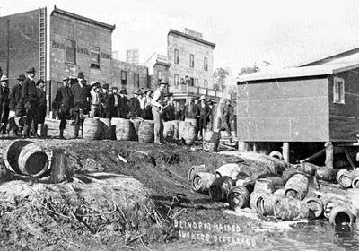
Primary Source
This primary source is important to the event because it illustrates the lengthy processes that the government went through on their attempt to stop alcohol in Canada. The police would go on raids where they suspected that alcohol was being sold, housed or produced. They would then proceed to dump the barrels of alcohol and render the substance useless, as well as impose fines and time to those in possession of it. This displeased the public, creating tension between the Government and the general public.
http://www.thecanadianencyclopedia.com/media/blind-pig-raided-4037.jpg

Slide 24
Historical Significance
Minimized the amount of crimes related to intoxication
Reduced the sales of liquor, pushing Canada into the depression
Raised tensions between the Government and the people of Canada
Rating: On the scale of 5 to -5 I gave this event a 0. The prohibition in Canada didn’t effect the future of Canada to a high extent. The prohibition may have been a nuisance for people during the time, but the effects of that have not trickled down to our time to make a big enough impact on today’s world.

Slide 25
Cited Sources
“Prohibition in Canada” Wikipedia. N.p. N.d. http://en.wikipedia.org/wiki/Prohibition_in_Canada
“Prohibition” The Canadian Encyclopedia. “Hurtig Publishers”. 1988. http://www.thecanadianencyclopedia.com/articles/prohibition

Slide 26
Statute of Westminster 1931
Jameson Kunkel

Slide 27
Description
The Statute of Westminster is an act, passed by the United Kingdom in 1931, that allows for the self governing dominions of the British Empire to have legislative independence and the right to their own affairs. This act is the basis of Canada's continual, positive relationship with Britain as it allows us to self govern while still being considered British Commonwealth. The main effect of the Statute of Westminster was to cease Britain's ability to pass legislature and dictate laws amongst it's Dominions.

Slide 28
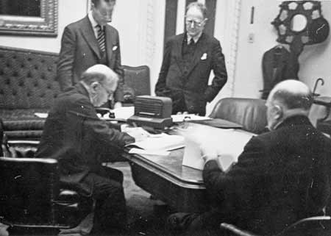
Primary Source
This source is a picture that contains Canadian Prime Minister, William Mackenzie undergoing a signing ceremony for the Statute of Westminster. This source is significant because it illustrates the atmosphere of the signing ceremony. Note the intense scrutiny of the men surrounding Mackenzie.

Slide 29
Historical Significance
The Statute of Westminster is historically significant to Canada because it represents a great leap forward in Canada's endeavour for full independence and sovereignty. This is because of the main things needed to be considered a self-sufficient nation is the ability to govern your own government in it's entirety. Canada was able to prove it self as a nation on the battle fields of World War One and felt that it deserved the right to independence.
Rating: +5

Slide 30
Sources
“Statute of Westminster” Wikipedia. N.d. N.p.
http://en.wikipedia.org/wiki/Statute_of_Westminster_1931
“The Statute of Westminster, 1931” Privy Council Office. N.d N.p
http://www.pco-bcp.gc.ca/aia/index.asp?lang=eng&page=hist&sub=westminster&doc=westminster-eng.htm

