Slide 1
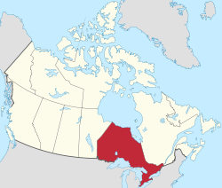
What about us?
Ontario

Slide 2
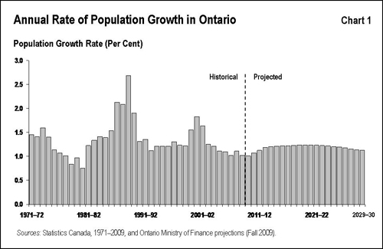
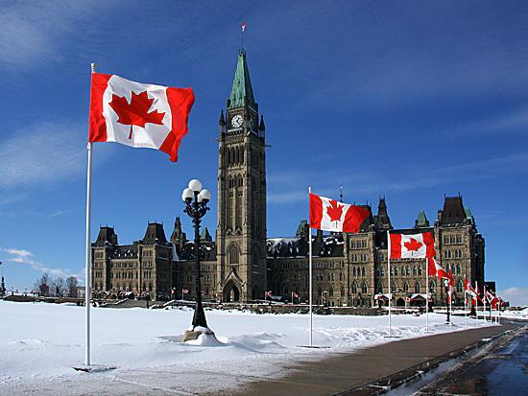
What factors make Ontario Canada’s most influential province?
It has over 1/3 of the population of Canada
Largest of all provincial economies
Place where the idea for Canadian Confederation was born
Home to the federal capital Ottawa

Slide 3
Facts about Ontario’s Population
13 210 667 people
5 million living in Metropolitan Toronto
Population concentrated in southeast region of the province
Second most diverse province next to BC
22.8% of population = visible minorities

Slide 4
Why Ontario was hit hard by the recent economic slowdown
Manufactory is a mainstay of the Ontario economy
The manufacturing industry depends on exports to other countries = affected by glocal recession

Slide 5
What other industires besides manufactoring are important?
Financial
Investment
Banking
Information technology industry (BlackBerry)
Tourism
Mining
Transportation
Forestry

Slide 6
What party is in power?
The Liberals have been in power since 2007.
Ontario Liberals made history Saturday January 12, 2013 in electing Kathleen Wynne, the province’s first female and openly gay premier,
Runner up Sandra Pupatello, right, celebrates Kathleen Wynne's victory and making her the first women Premier at the Ontario Liberal Leadership convention in Toronto on Saturday.

