Slide 1
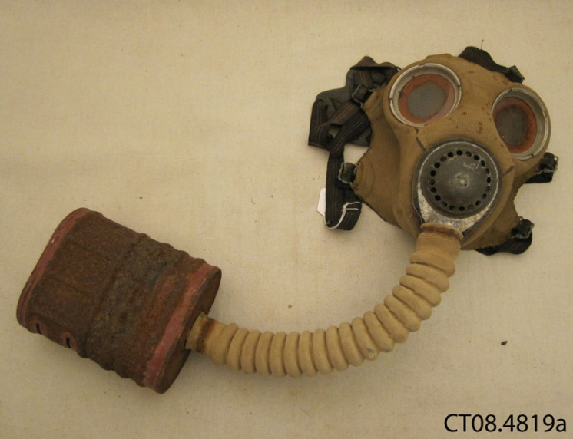
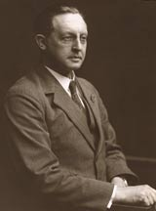
Gas mask
Dr. Cluny Macpherson in 1902.
World War 1 Gas Mask
Dr. Cluny MacPherson refined the gas mask in 1915 during World War 1 in France. Why was this event so historically significant to Canada? What effect did this have on Canadians during this time?

Slide 2
Descriptive paragraph
Allied troops realized they needed some sort of protection against gas, after the Germans used a Chlorine gas attack at The Battle of Ypres, 1915.
Only protection at this point was a handkerchief or fabric soaked in urine, over the mouth/nose.
Cluny invented the world’s first gas mask by taking a German helmet, attaching a cloth hood with a tube for breathing and eye holes. He then soaked this in different chemicals that would absorb Chlorine gas.
It was called the MacPherson Respirator, and was the first ever gas mask used by the British army.
Gas masks are worn today by millions of soldiers, and have saved countless lives, as well as protecting soldiers from eye and respiratory injury.
Widely considered the most important invention in World War 1

Slide 3
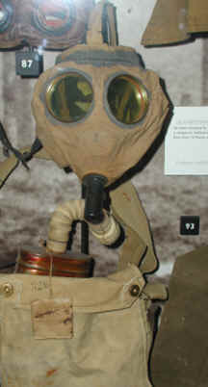
Primary Source/Importance
This is a “Cluny
Respirator” from
1917.
This Primary Source is important because:
-It shows us how our grandparents and great grandparents fought war.
-It is one of the first gas masks ever made
-Having these type of masks allowed future generations to improve upon Cluny’s Design
-The mask saved thousands of soldiers in World War 1 and continues to save soldiers in modern conflicts
-It made German gas attacks less effective, and helped soldiers in the war hold their position while they were under attack

Slide 4
Historical Significance
Historically significant to Canada because although we were just beginning out as an independent nation, we contributed to a global conflict in a large way by helping save thousands of lives with the mask
Historically significant because it made gas attacks less common and less effective during, and after the war. Gas masks changed the way war is and will be fought forever.
It continues to be historically significant because the gas mask is still used around the world, even outside of conflict
Rank: +5
I gave the gas mask a rating of +5, because it was not just a significant invention during the time, but continues to be a valuable tool throughout the world for many people. It changed the way war is fought, making gas attacks much less fatal. Although it is impossible to know how many lives it has saved, the mask has been called the most important invention of the first world war, and has most likely saved, and continues to save, hundreds of thousands of lives.

Slide 5
Sources
Trueman, Chris. "Gas Masks in World War One." History Learning Site. Web. 26 Apr 2013. <historylearningsite.co.uk>.
"Incredible Inventions: Gas Mask." Library and Archives Canada. 11 02 2005. Web. 26 Apr 2013. <collectionscanada.gc.ca>.

Slide 6
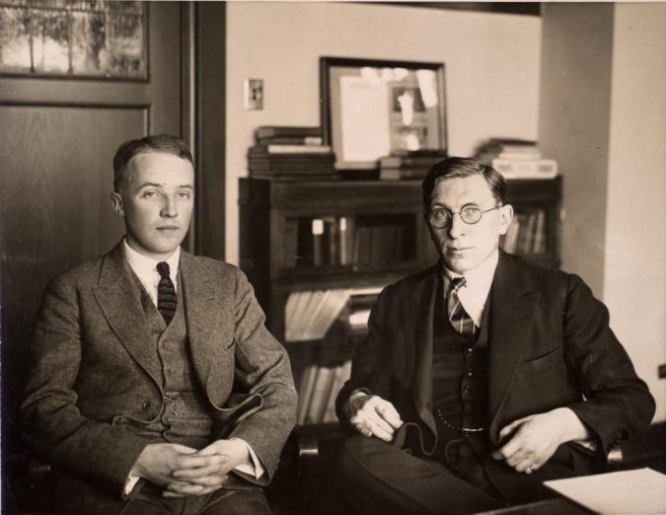
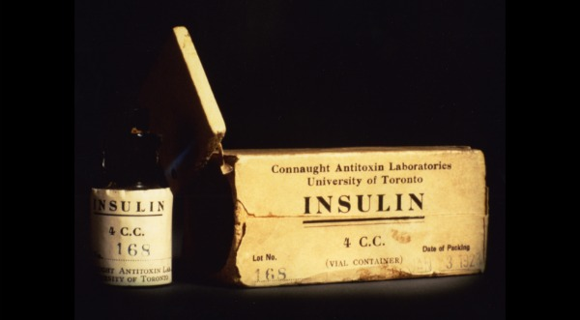
The Discovery of Insulin
http://heritage.utoronto.ca/fedora/repository/default%3A11761
http://speakingofresearch.com/2011/08/03/from-science-to-miracle-in-2-years-the-discovery-of-insulin/
Above is a picture of one of the first containers holding insulin usable for humans.
Above is Dr. Fredrick Banting (right) and his assistant Charles Best (left). The pair to discover insulin.
Insulin was discovered by a group of doctors to help people who are diabetic control their blood sugar levels. One doctor and one assistant were involved with the experiments before so many advancements were made that required more workers. If it was not discovered by them in 1920, it may never have been.
By: Spencer Jaschkowski

Slide 7
Descriptive paragraph
Discovered late 1921 at the University of Toronto by Dr. Fredrick Banting and his assistant Charles Best, along with the other scientists J.J.R. Macleod and James Collip
Testing started during the summer of 1921 at an under equipped laboratory and tested on dogs
After removing the pancreas from dogs for tests, they found it had developed diabetes
They then sliced another experiments pancreas, froze it, then sliced it up and isolated it; first called isletin
They injected another dog with diabetes with the isolated and filtered isletin, and it became healthier and stronger showing less side effects of diabetes, proving the formula was starting to work
With the success, they then moved on to using cows because they needed a larger supply to keep the diabetic dogs alive and to test, and resulted in extra isletin being made
The name insulin was suggested by their supervisor, which was agreed on
They were moved to a fully equipped laboratory with another scientist(Collip) where he was to purify it greatly so the new found insulin could be used on humans
Once purified as much as they could, Dr.Banting and Mr.Best started injecting themselves with the insulin to test it, although not diabetic. They suffered no severe side effects, except weakness and dizzyness
In 1922 the first person to receive the insulin was a young dying boy in the hospital who would have died if not given it, the insulin saved his life and made him rapidly regain his health and strength
After saving the boys life, Macleod with knowing many people helped get the word out about insulin very quickly, and in 1923 was creating enough insulin to provide the entire North American continent
The same year in 1923, Dr.Banting and the supervisor Macleod received the prize; which infuriated Banting because he knew Best and him should have. The prize money was split from both Banting and Macleod

Slide 8
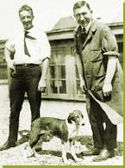
Primary Source
Left, a picture of Dr.Banting and Charles Best with one of their diabetic dogs.
Importance?
http://www.nobelprize.org/educational/medicine/insulin/discovery-insulin.html
Important because it shows the two main doctors involved in the finding and creation of insulin
It shows the type of animal that they tested on, and that it actually had diabetes
That insulin will not only help humans, but other animals also (ex. Cows and dogs)
These men saved thousands of people then, millions now, and millions in the future
Since our topic is inventions, insulin was one of the greatest inventions of its time due to it’s ability to alter the effects of diabetics and put them into a semi-normal life
It shows that they are extremely smart and educated to be able to figure out the formula and how to purify the insulin, and they are all Canadian which is nothing but a bonus

Slide 9
Historical significance
The discovery of insulin is historically significant because the idea, experiments and the final products were all made and discovered in Canada, at the University of Toronto less than an hour away from us. The discovery saved thousands and thousands of people when it was discovered, and it has saved millions of people to this day worldwide. It has changed the lives of people in every single country, and how people live with the disorder. The disorder will most likely never disappear, so insulin will never be put out of use. Even though it may not cure the disorder, it will keep them in a close to normal life where they can do just as much as normal people and not be excluded from the foods that would otherwise cause them to be in a harsh situation. These men will always be remembered because they changed the way people live and think throughout the world; something that will never be forgotten.
Rank: +5
The reason I have given the discovery of insulin the rank of +5 is because mainly, it saves lives. Thousands then, and millions now. It changes the way diabetes is fought against, and it will continue to save lives every single day. There is no cure to diabetes, but this is the closest you can get by minimalizing it. There is no other option or other drugs you can use to calm the diabetes, you have to use insulin. Without it, thousands of people would die every single day. If insulin was not around, many people who had diabetes and were inventors might have died, and their product might have never been around today.
- 347 million people worldwide have diabetes, and would all die without it
- Diabetes usually runs in a family, so all degenerates of a family will have the disorder for their whole life

Slide 10
Sources
"The Discovery of Insulin". Nobelprize.org. 26 Apr 2013 <http://www.nobelprize.org/educational/medicine/insulin/discovery-insulin.html>
Marsh, James. "The Discovery of Insulin." The Canadian Encyclopedia. Web. 26 Apr 2013. <http://www.thecanadianencyclopedia.com/featured/the-discovery-of-insulin>.
Zuger, Abigail. "Rediscovering the First Miracle Drug." Health. NY Times, 04 10 2010. Web. 26 Apr 2013. <http://www.nytimes.com/2010/10/05/health/05insulin.html?_r=2&hp=&pagewanted=all&>.

Slide 11
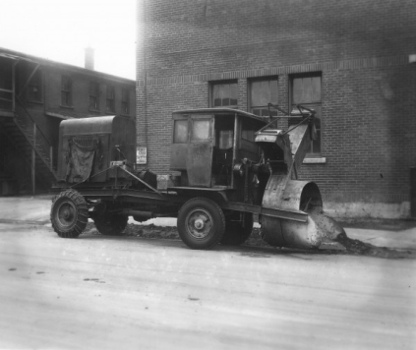
Snow Blower
Snow blower you would commonly see in the 20s and 30s
Canadian Inventor Arthur Sicard in 1925
Canadian inventor Arthur Sicard, invented the Snow Blower in 1925. One of Canada's prime automotive inventions in the 20’s and 30’s. Why Was this event so historically significant to Canada? and what effect did this have on Canadians during this time?
Liam Cormier

Slide 12
Descriptive Paragraph
Arthur Sicard was born in Saint-Leonard-De-Port-Marie in Quebec in 1876 and died on September 13 1946. During his time he worked a hard job for most of his life on a farm, he noticed how the tractors farmers would use used blades to get wheat or crops. He thought to himself what if I could invent something that could do that with snow and make life easier in the harsh winters of Quebec by removing the snow where its not needed. In the winter of 1925, he tested his newly invented snow blower called “Sicard Snow Remover Snow Blower” people in the city were amazed at this invention roaming the streets of Montreal and it created such a positive impact in the city it made roads safer and less money would have to be used to get labour to clear out the roads of snow. People could now access certain needs in the town without have so much snow in the way. The first snow blower was sold too the nearby town of Outremont in 1927.

Slide 13
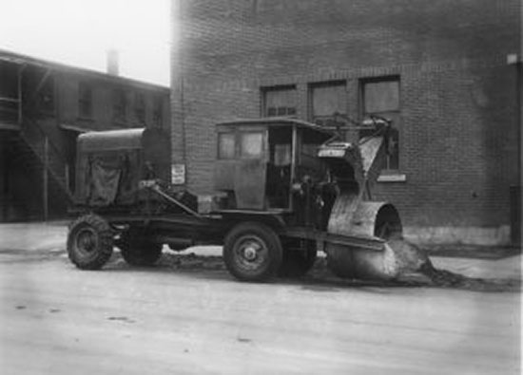
Primary source
Arthur Sicard first snow blower in 1925. People of Montreal were astonished to see the strange-looking truck down the roadway. The road the truck had passed over was smooth and clear and created a safe way for people in Montreal to navigate.

Slide 14
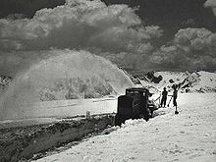
Historical significance
Arthur Sicard created one of Canada’s famous inventions of the 20s and his invention is still used to this day. Not only did this effect our country but it effect lots off other countries globally who share the same problem as Canada does during the harsh winters.
People in Canada in other countries could now get to places easier by cars.
People globally could now access necessities for survival in the winter.
Canada would save a lot of money on using the snow blower instead of paying for labour to clear the streets.
Canada influenced America and started manufacturing Snow blowers for the U.S.
Ranking 1: Even if it did affect history globally this event was not one of Canada’s greatest but it has a positive impact in history by making the removal of snow easier and faster for many many people. Without it, during the winter season people may not have been able to leave their residences and be trapped inside, leading to other things like starvation if they could not exit to get supplies.

Slide 15
sources
Cox, Jennifer. "Top 10 Canadian Inventions." CraveOnline. N.p., 18 October 2011. Web. 26 Apr 2013.
"Arthur Sicard – Inventor of the Snow Blower." edublogs. N.p., 31 may 2012. Web. 26 Apr 2013. <http://abobo.edublogs.org/2012/05/31/arthur-sicard-inventor-of-the-snow-blower/>.
"Snowblower ." Flagro. Tron-Halvard Fladby, 3 Sep 2006. Web. 26 Apr 2013. <http://flagro.fladby.com/en/snowblower>.
Bellis, Mary. "Who Invented the Snowblower?." About.com. ©2013 About.com. Web. 26 Apr 2013. <http://inventors.about.com/od/sstartinventors/a/snowblower.htm>.

Slide 16
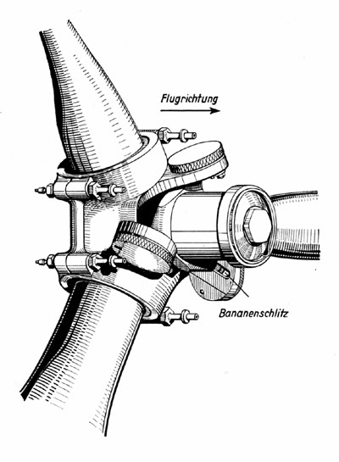
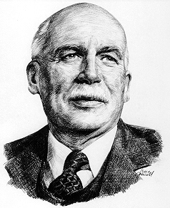
Inventors: New Inventions and Technology
http://i18.photobucket.com/albums/b142/apollyonsun/Luftwaffe%20Reviews/Junkers_Variable_Pitch_PropellerBsm.jpg
http://www.collectionscanada.gc.ca/eppp-archive/100/200/301/ic/can_digital_collections/aviation/mp088.jpg
Invention of the Variable-Pitch Propeller
The variable-pitch propeller invented by Wallace Rupert Turnbull in 1927 was a significant contribution to the evolution of the airplane.
Nick Ciulei

Slide 17
Descriptive Points
The variable-pitch propeller was invented by Wallace Rupert Turnbull, a Canadian aeronautical engineer.
The mechanism was designed to be capable of adjusting the angle at which the propeller blades cut through the air.
This adjusting was essential for safe, efficient flying at different speeds (similar to how a car requires a gear box).
In 1909, Turnbull won a medal from the Royal Aeronautical Society for his research.
His most significant invention (adjustable propeller) was tested in flight in June 1927 which was a success.
Turnbull later licensed his invention for manufacture which made it possible for all countries to use it and make changes.
Wallace Turnbull was born in Saint John, New Brunswick.
His studies led him to Germany for a short while to study science.
After an expensive education, Turnbull worked at the Edison Lamp Works in New Jersey for 6 years.
Wallace Turnbull’s invention improved the Canadian identity even more after our respect-earning presence in WWI because it was appreciated by so many countries as they used it to maximize their airplanes’ efficiency.

Slide 18
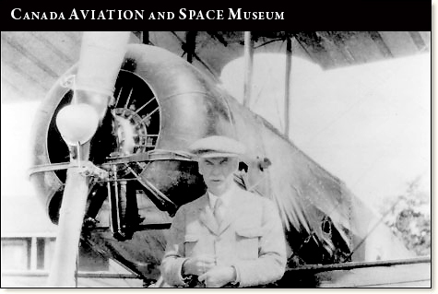
Primary Source
This is a photo of Wallace Turnbull beside a plane equipped with his adjustable propeller.
The primary source is one of the few photos taken of Wallace Turnbull and his invention which is why it is in the Canada Aviation and Space Museum.
1927, when the propeller was tested successful in flight was likely around the same time period that the photograph was taken.
In this time period, photographs were rarely taken which makes this photo significant to remembering Canadian inventions in the early 20th century.
http://www.aviation.technomuses.ca/postcards/3/

Slide 19
Historical significance
The invention of the variable-pitch propeller is rated a +1 in historical significance.
Although the efficient flying mechanism was not used until after the first World War, its basic idea was the backbone to the improved air warfare of WW II.
This invention is historically significant because it was a breakthrough in propeller technology.
Countries such as Russia and the United States (F.W. Caldwell) were working on controllable propellers at the same time as Turnbull. But Turnbull was the first to successfully use an electronic motor to adjust the propeller blades mid-flight.
This accomplishment added to Canada’s improving identity because we were first making significant contributions through our army’s abilities, but this is an example of a technological contribution from Canada that was recognized worldwide.
After being successful in flight, Russia, USA and Germany began using this design to make improvements for their own aircraft benefits.

Slide 20
Sources
“Development of Aviation Technology.” Century of Flight. N.p, n.d. Web. April 24.
Phillipson, Donald J.C. “Wallace Rupert Turnbull.” The Canadian Encyclopedia. N.p, n.d. Web. April 24.

Slide 21
First Canadian national broadcast
Timeline – 1927
Coast to coast broadcast from the newly created CN station in Ottawa on July 1st
Nikola Stanojcic

Slide 22
Descriptive paragraph
http://www.greenjoyment.com/teslas-inventions-are-more-than-wireless-electricity
Gugliemo Marconi - Own station in Toronto (1927)
First wireless radio in Toronto (1919) – First radio broadcast in Montreal (1920)
Ted Rogers - Personal battery radio (1924)
First national broadcast (23) , Diamond Jubilee of Queen Elizabeth II
40 000 – 50 000 live, even more tuned in making it the largest to date
Started the induction of radios into households (cheap and useful market)

Slide 23
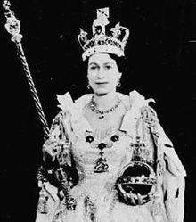
Primary source
http://en.wikipedia.org/wiki/File:Coronation_of_Queen_Elizabeth_II_X.jpg
Diamond Jubilee celebration (60th year monarchy) photograph
Controlled Canada back then
Shows how the radio allowed Canadians to celebrate and connect on a national level
Poet Wilson Macdonald penned an ode to the broadcast “A million hearers, forward-leaning / were thrall in eloquence.”
Proves the impact the radio had on Canadian people & Canadian identity

Slide 24
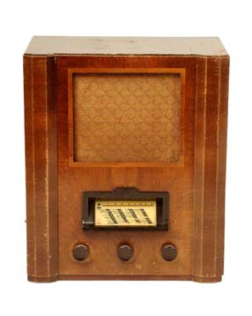
Historical significance to Canada
The invention of radio as a whole would be a +4/5 in my opinion
Very widespread due to the fact that it was cheap, available
People in remote areas are now connected with the rest of society
In 1923 there were 10,000 radios and by the end of the decade over 300,000
Gave Canadians something to do in time of economic prosperity
Improved Canada/U.S relations and brought them closer
Started the broadcasting of hockey
Revolutionized communications technology
Improved quality of life
http://www.museumoflondon.org.uk/Collections-Research/Research/Your-Research/X20L/objects/record.htm?type=object&id=66052

Slide 25
Sources
"Roaring Twenties - Inventions." History Class. Tripod.
Web. 25 Apr. 2013.
"1927: Diamon Jubilee broadcast links Canadians." CBC Disital Archives. CBC,
30 Apr. 2012. Web. 25 Apr 2013.
Rutherford, Paul. "Radio Programming." The Canadian Encyclopedia. Historica-Dominica. Web. 26 Apr. 2013.
"Inventions of the 1920s in Canada." Blogspot. Historica-Dominica,
15 Mar. 2010. Web. 26 Apr. 2013.

