Slide 1
Workers: Working Conditions And Lifestyle
Jericco Vera, Jason McTavish, Miki Matsuoka, Rosie Hill, Webster Steele, and Israa Elkork

Slide 2
Spanish Flu Epidemic 1918
Jericco Vera

Slide 3
Descriptive Paragraph
The Spanish flu affected many people in and out of work.
The flu made people unable to work because employers were scared of spreading the flu to other workers causing production to stop.
Even on the outskirts of towns and cities the flu was dreadfully severe.
The effect The Spanish flu was on people was devastating.
It broke apart families, took their lives.
Families were at a economic downfall.
Lots of men not working because of the flu.
The death toll of the Spanish flu was over 100 Million dead all over the world, In Canada alone it was close to 70,000.
Canadians were running out of space to bury the dead, they held mass graves to bury the dead.

Slide 4
Ranking
+5
The Spanish influenza had a massively negative impact.
It put hundreds of thousands in pain and death.
It was a horrible 3 years for the world.

Slide 5
Sources
http://en.wikipedia.org/wiki/1918_flu_pandemic
Billings, Molly. "The 1918 Influenza Pandemic." Web log post. The 1918 Influenza Pandemic. N.p., June 1995. Web. <http://virus.stanford.edu/uda/>.
Higgins, Jenny. "The 1918 Spanish Flu: Newfoundland and Labrador Heritage." The 1918 Spanish Flu: Newfoundland and Labrador Heritage. N.p., 2007. Web. <http://www.heritage.nf.ca/law/flu.html>.

Slide 6
One Big Union 1919
Jason McTavish

Slide 7
Descriptive Paragraph
Initiated formally in Calgary on March 13, 1919
At it's peak in 1920 the OBU had close to 50,000 members from Northern Ontario to the Pacific, with other locals eastern and Central Canada and the US
Beliefs of many OBU members were similar to those of the communist revolutionaries in Russia and of the international communist movement
To achieve their goals OBU members supported general strikes
The general strike that began in Winnipeg on May 15 was not associated organizationally with the OBU, yet the federal government and some conservative labor politicians accused the OBU of instigating it
The idea for One Big Union began with the Industrial Workers of the World
The IWW and OBU adopted the communist slogan: “Workers of the World, Unite.”
The OBU had an anti-capitalist policy
At the Calgary meeting, delegates proposed a country-wide general strike on June 1 if the government did not respond to their demands
Thousands of workers joined it, including large parts of the mine, transportation and logging labour force
In 1923 the union was reduced to approximately 5000 members

Slide 8
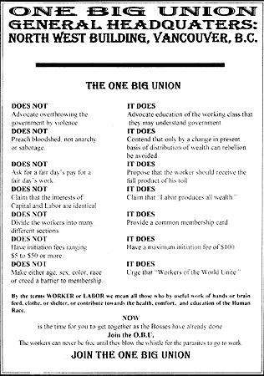
Primary Source
This picture is important on my topic because it represents One Big Union wanting to attract workers to join the One Big Union.
Plawiuk, Eugene. "LA REVUE GAUCHE." LA REVUE GAUCHE. N.p., n.d. Web. <http://plawiuk.blogspot.ca/2005/08/canadas-first-internment-camps.html>.

Slide 9
Historical Significance & Ranking
+2
This event affected working conditions and lifestyle from 1918-1938 in a positive way because it help to start the creation of workers unions. The Creation of One Big Union allowed workers to collectively improve working conditions, wages and benefits, hours and job safety etc.
I gave this event a +2 impact because it affected workers all over Canada and parts of the US.

Slide 10
Sources
Bercuson, DJ. "One Big Union." - The Canadian Encyclopedia. N.p., n.d. Web. <http://www.thecanadianencyclopedia.com/articles/one-big-union>.
http://en.wikipedia.org/wiki/One_Big_Union_(Canada)
Book
Colyer Jill, et al. Creating Canada: A History-1914 to the Present; Toronto: 2010. Print.

Slide 11
Winnipeg General Strike 1919
Miki Matsuaka

Slide 12
Descriptive Paragraph
Factories shutting down
Soaring unemployment rates
Increasing bankruptcies
Immigrants taking over the veterans former jobs
Basically labour work/ bad working conditions
The workers formed a strike against the government
May 22, 1919 –the justice Minister and labour Minister travelled to Winnipeg to meet representative citizens but leaders of the strike of workers were not invited
May 30 – the police refused to sign the contract with the workers and said they would continue to maintain law and order
They (the police) were fired and replaced by an 1800-man force known as “Specials”
June 17 – government arrests 10 leaders of the Central Strike Committee and 2 propagandists from “One Big Union”
June 21 – the veterans organised a parade to protest the restrictions and a total of 6000 people gathered in front of the city hall
A streetcar operated by strike breakers approached on its route when the veterans overturned it and set it on fire
The Specials and the Mounted police charged at the crowd
2 leaders, Fred Dixon and J.S. Woodsworth were arrested, about 30 casualties including 2 deaths
6 leaders were released but 7 were unfairly convicted of a conspiracy to overthrow the government
June 26 – afraid of more violence, the leaders call off the strike

Slide 13
All persons employed by the City should express their willingness to execute an agreement, undertaking that they will not either collectively individually at any time go on strike but will resort to arbitration as a means of settlement of all grievances and differences which may not be capable of amicable settlement
Bumsted, J.M. (1994). The Winnipeg General Strike of 1919: An Illustrated History.
Watson Dwyer Publishing Ltd. P. 12. ISBN 0-920486-40-1.
This is from the Fowler Amendment to say that the City council does not accept the proposal without their amendments. This was another reason the civic employers further incensed and by Friday May, 24, approximately 6,800 people joined the strike.

Slide 14
Historical Significance & Ranking
+5
This event holds a negative impact to the workers because as a result of the strike, many got hurt and 2 people even died from it. Also, after they called off the strike, it took nearly 3 decades for Canadian workers to be able to have a secured union recognition and collective bargaining.

Slide 15
Sources
Books:
Bumsted, J.M. (1994). The Winnipeg General Strike of 1919: An Illustrated History.
Watson Dwyer Publishing Ltd. P. 12. ISBN 0-920486-40-1.
Websites:
Reilly Nolan J. “Winnipeg General Strike”. The Canadian Encyclopedia. 2012. Web. 19, April, 2013.
“The Winnipeg General Strike”. CBC. 2001. Web. 20, April, 2013.
“The Winnipeg General Strike”. Historica. Web. 20, April, 2013.
“The Winnipeg General Strike”. Timetoast. Web. 20, April, 2013.
“Winnipeg General Strike”. Wikipedia. 11, April, 2013. Web. 19, April, 2013.

Slide 16
On To Ottawa Trek 1935
Rosie Hill

Slide 17
Descriptive Paragraph
Federal relief camps setup for men after depression (one in nine in need of relief)
Men paid 20 cents per day to work on roads and public works
Poor working + living conditions lead to unrest among workers
Thousand of relief camp men went on strike on April 1935 protesting unacceptable conditions of federal relief camps and pay
On April 4th 1935 1,600 strikers headed to Vancouver
After two months of protesting in Vancouver, BC strikers decided to bring issues to federal government headquarters in Ottawa
On June 3rd 1935 hundreds of men boarded boxcars to take grievances to Ottawa

Slide 18
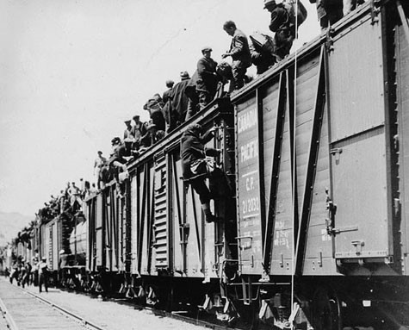
Primary Source
Strikers boarding boxcars to go to Ottawa
Shows commitment men had to get issues resolved
Picture shows hundreds of unemployed men ready to stand up for their rights
http://upload.wikimedia.org/wikipedia/commons/3/37/Kamloops_on_to_Ottawa.jpg
“On-to-Ottawa Trek” Wikipedia. 23 April 2013. Web. 23 April 2013

Slide 19
Historical Significance & Ranking
1
The On To Ottawa strike raised awareness of the poor working conditions in the relief camps, forcing workers to take action and protest these conditions. Although the strike raised awareness of poor working conditions in the relief camps after 2 months of striking no change to the working conditions occurred. Therefore, making the strike important to workers because it was the first step towards workers realising there wanted rights and unions; but not that important as a whole because nothing was accomplished during this two month strike.

Slide 20
Sources
Book:
Colyer Jill, et al. Creating Canada: A History-1914 to the Present; Toronto: 2010. Print.
Website:
“On-to-Ottawa Trek” Wikipedia. 23 April 2013. Web. 23 April 2013
“On To Ottawa Trek” On To Ottawa Historical Society. 15 February 2013. Web. 22 April 2013

Slide 21
Regina Riot 1935
Webster Steele

Slide 22
Descriptive Paragraph
Started by men protesting working conditions to the government
The men travelled across the prairies to Ottawa but were stopped by RCMP in Regina
The Riot ended in a brutal attack on workers by police and RCMP at a rally on July 1st, 1935
News of the RCMP and Police brutality spread across Canada and left many people questioning authority

Slide 23
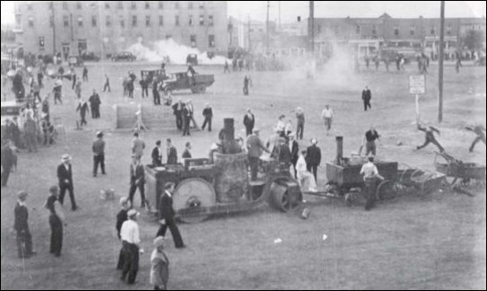
Primary Source
This picture shows several workers on looking the fighting during the riot
"Tracking the Trekkers: Revisiting the Regina Riot." Prairie History Blog. N.p., 5 June 2011. Web. <http://www.reginalibrary.ca/blogs/index.php?blog=7>.

Slide 24
Ranking
+3
This riot brought awareness to workers across Canada and helped to start several more protests.
Several of the workers demands were met
The public support of the riot led to the welfare provisions in the post depression era
Many workers were hurt and injured in the protests

Slide 25
Sources
Zeuhlke, Mark, and Bill Waiser. "On-to-Ottawa Trek." Wikipedia. Wikimedia Foundation, 23 Apr. 2013. Web. 25 Apr. 2013.
Snider, Michael. "On to Ottawa Trek/Regina Riot." The Canadian Encyclopedia. N.p., 1 July 2002. Web. 25 Apr. 2013.

Slide 26
The GM Strike (Oshawa Strike) 1937
Israa Elkork

Slide 27
Descriptive Paragraph
The Oshawa Strike occurred from 8-23 April 1937, when more than 4,000 workers of the huge General Motors plant in Oshawa, Ontario, struck.
Their requests were simple: an 8-hour day, better wages and working conditions, a priority system and recognition of their union, the new United Automobile Workers. This last demand had caused the strike.
General Motors management struggled to keep the Committee for Industrial Organization (CIO) out of Ontario, which organizes industrial workers throughout the US.
Both the company and Premier Mitchell Hepburn, wanted an obedient labour force- unorganized, weak and cheap.
Eventually, General Motors, afraid of losing markets to its competitors, surrendered.
On the April 23rd agreement, GM accepted many of the union's demands.

Slide 28
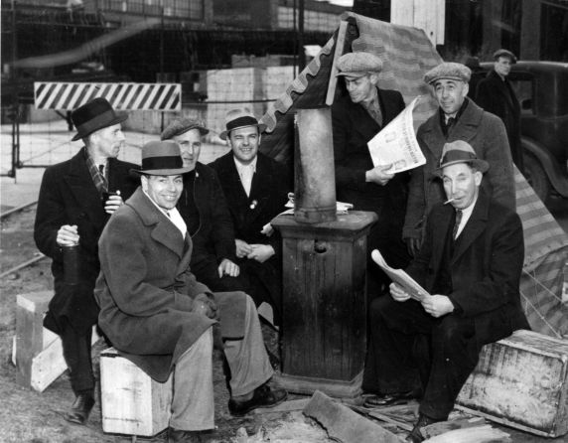
Primary Source
Striking GM workers.
Shows workers sitting outside the GM plant in Oshawa in the mud and filth, clearly happy.
Lewis, Philip. "Oshawa's Auto-workers vs. the "Sons-of-Mitches"" The GDP Blog. N.p., 2009. Web. <http://gdp.nfb.ca/blog/news/oshawa’s-auto-workers-vs-the-“sons-of-mitches”/>.

Slide 29
Historical Significance & Ranking
+2
The strike marked the birth of industrial unionism in Canada.
The strike would alert corporate firms on the need to improve infrastructure in the areas they work from. These strikes can also lead to building of more schools and health facilities that will benefit the community in Canada.
During strikes, some employees may be let off with a warning and in extreme cases, staff may be laid off. This leaves families without a source of income. Eventually people start getting anxiety, with some people becoming homeless due to failure to pay rent while others turn to crime. Therefore, leaving Canada in a very bad economy and community.

Slide 30
Sources
Abella, Irving. "Oshawa Strike." The Canadian Encyclopedia. N.p., n.d. Web. <http://www.thecanadianencyclopedia.com/articles/oshawa-strike>.
"CAW Local 222 - Who We Are - History." CAW Local 222 - Who We Are - History. N.p., 2012. Web. <http://www.cawlocal.ca/222/history.asp>.

